Slide 2
DIETARY TIPS FOR THYROID HEALTH AND MANAGEMENT OF THYROID DISORDERS.
RD. LD. FRANK AYIMADU
(ONCOLOGY DIETITIAN)

Slide 3
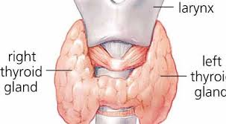
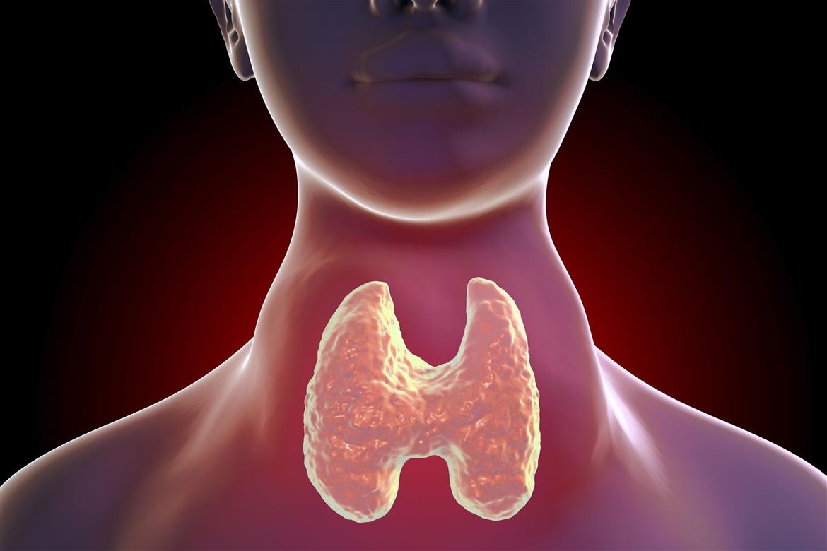
THE THYROID GLAND

Slide 4
Functions of the thyroid gland

Slide 5
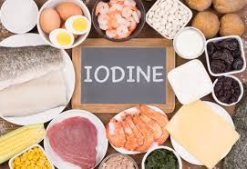
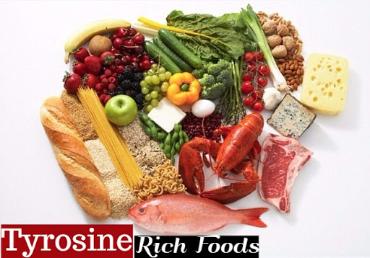
THYROID hormones
The thyroid Produces hormones called the T3 and T4 using two components
Iodine ( Trace element)
Tyrosine ( an amino acid)

Slide 6
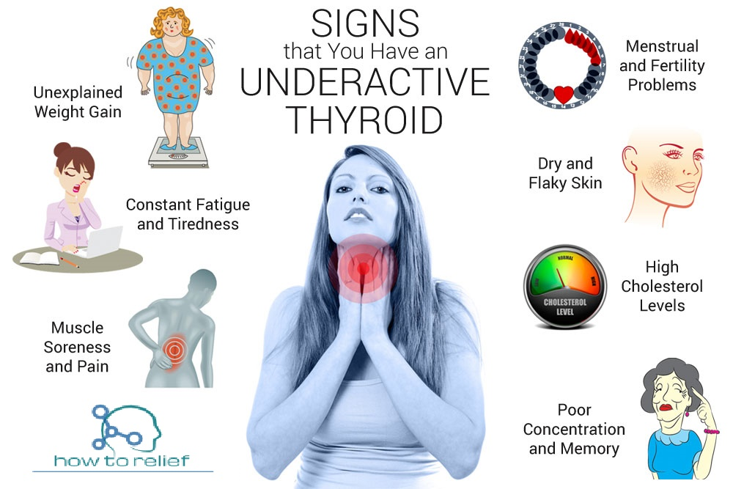
IMPAIRED THYROID FUNCTION
HYPOTHYROIDISM ( UNDERACTIVE THYROID)
Insufficient thyroid hormone
Notes:
Primary hypothyroidism Iodine deficiency- most common cause worldwide Congenital Autoimmune mediated Hashimoto’s thyroiditis- B lymphocytes invade thyroid Iatrogenic- post-thyroidectomy or radio-iodine treatment Drug-induced – Anti-thyroid, lithium, amiodarone Severe infection Trauma to thyroid/pituitary/hypothalamus Pituitary tumour

Slide 7
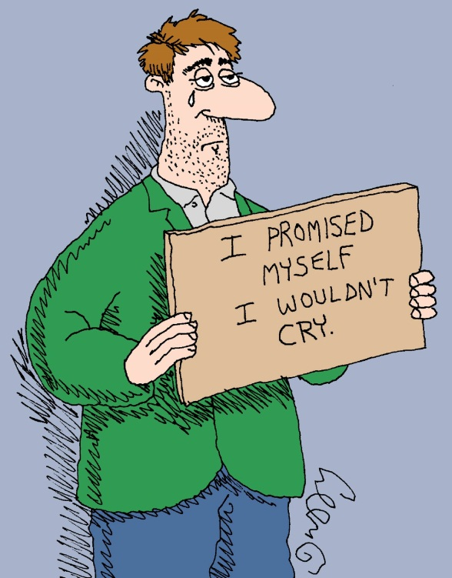
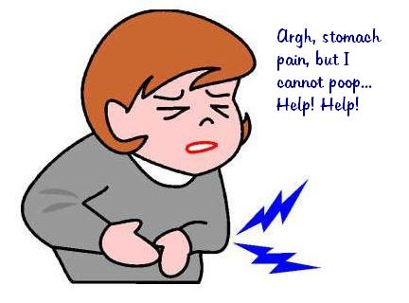
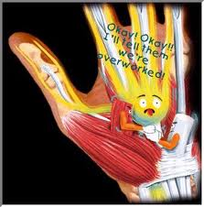
SYMPTOMS OF HYPOTHYROIDISM

Slide 8
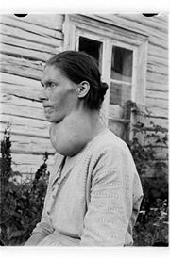
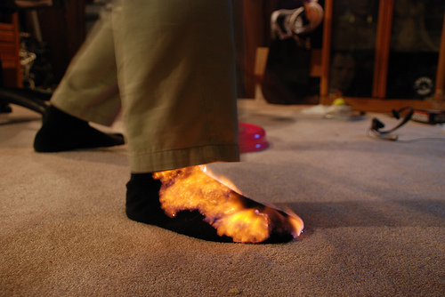
SYMPTOMS of hypothyroidism

Slide 9
SYMPTOMS OF UNDERACTIVE THYROID
Fatigue
Intolerance to cold
Constipation
Dry skin
Weight Gain
Puffy face
Hoarseness
Muscle weakness

Slide 10
SYMPTOMS OF UNDERACTIVE THYROID
Elevated blood cholesterol
Pain/ swelling of Joints
Heavier than normal Menses/ irregular periods
Thinning of hair
Slowed heart rate
Depression
Impaired Memory
Goiter ( enlarged thyroid gland )

Slide 11
DIETARY TIPS
Changing the diet cannot cure hypothyroidism, but the diet plays three main roles in managing the condition:
Foods that contain certain nutrients, such as IODINE, SELENIUM and ZINC, can help maintain healthy thyroid function.
Some foods may negatively impact thyroid function and worsen symptoms of hypothyroidism.
Some foods supplements can interfere with how well the body absorbs thyroid replacement medicine, so limiting these foods can also help.

Slide 12
IODINE
Milk
Iodized salt***
Seawater fish
Sea weed
Whole egg ( with yolk)

Slide 13
SELENIUM
Nuts ( Peanuts, Cashew nuts, almonds, Brazil nuts )
Tuna
Shrimps
Egg
Whole wheat bread
oatmeal

Slide 14
ZINC
Oysters
Crabs
Legumes ( beans, lentils)
Seeds ( pumpkin, sesame, chia, flaxseeds)

Slide 15
GOITROGENS
Broccoli
Cauliflower
Cabbages
Radish
Kale
Turnips
Brussel sprouts

Slide 16
SOY
Soymilk
Soy sauce
Tofu
Miso
Edamame
Soy based products

Slide 17
GLUTEN
Wheat
Ryre
Barley

Slide 18
PROCESSED FOODS
Fast foods
Cakes
Hot dogs
Pizza
Soft drinks

Slide 19
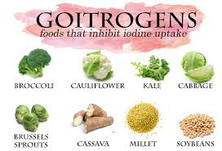
Dietary tips

Slide 20
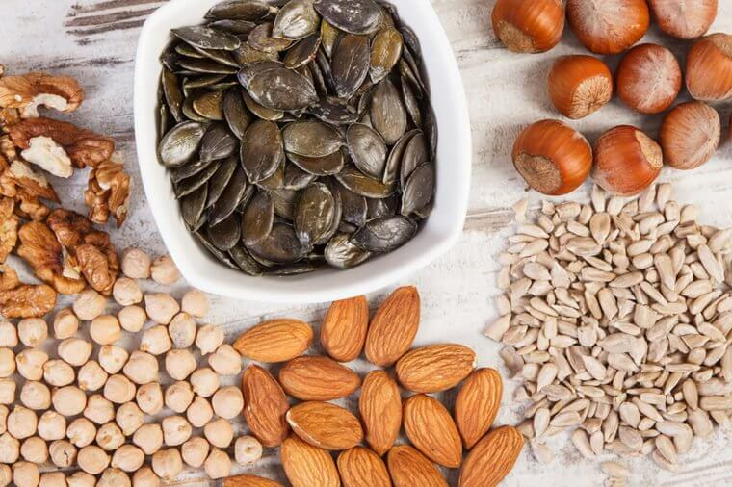
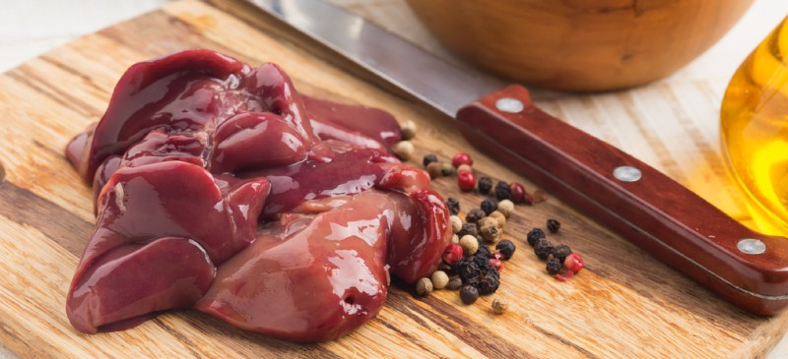
Dietary tips – selenium, zinc, iron

Slide 21
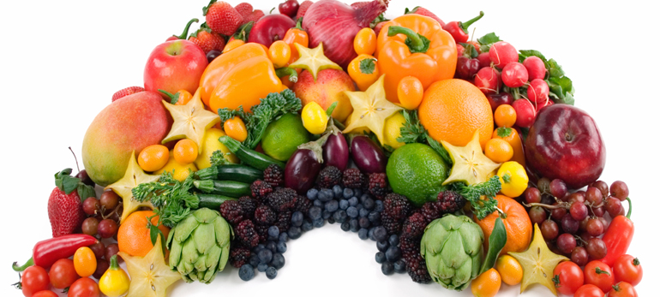
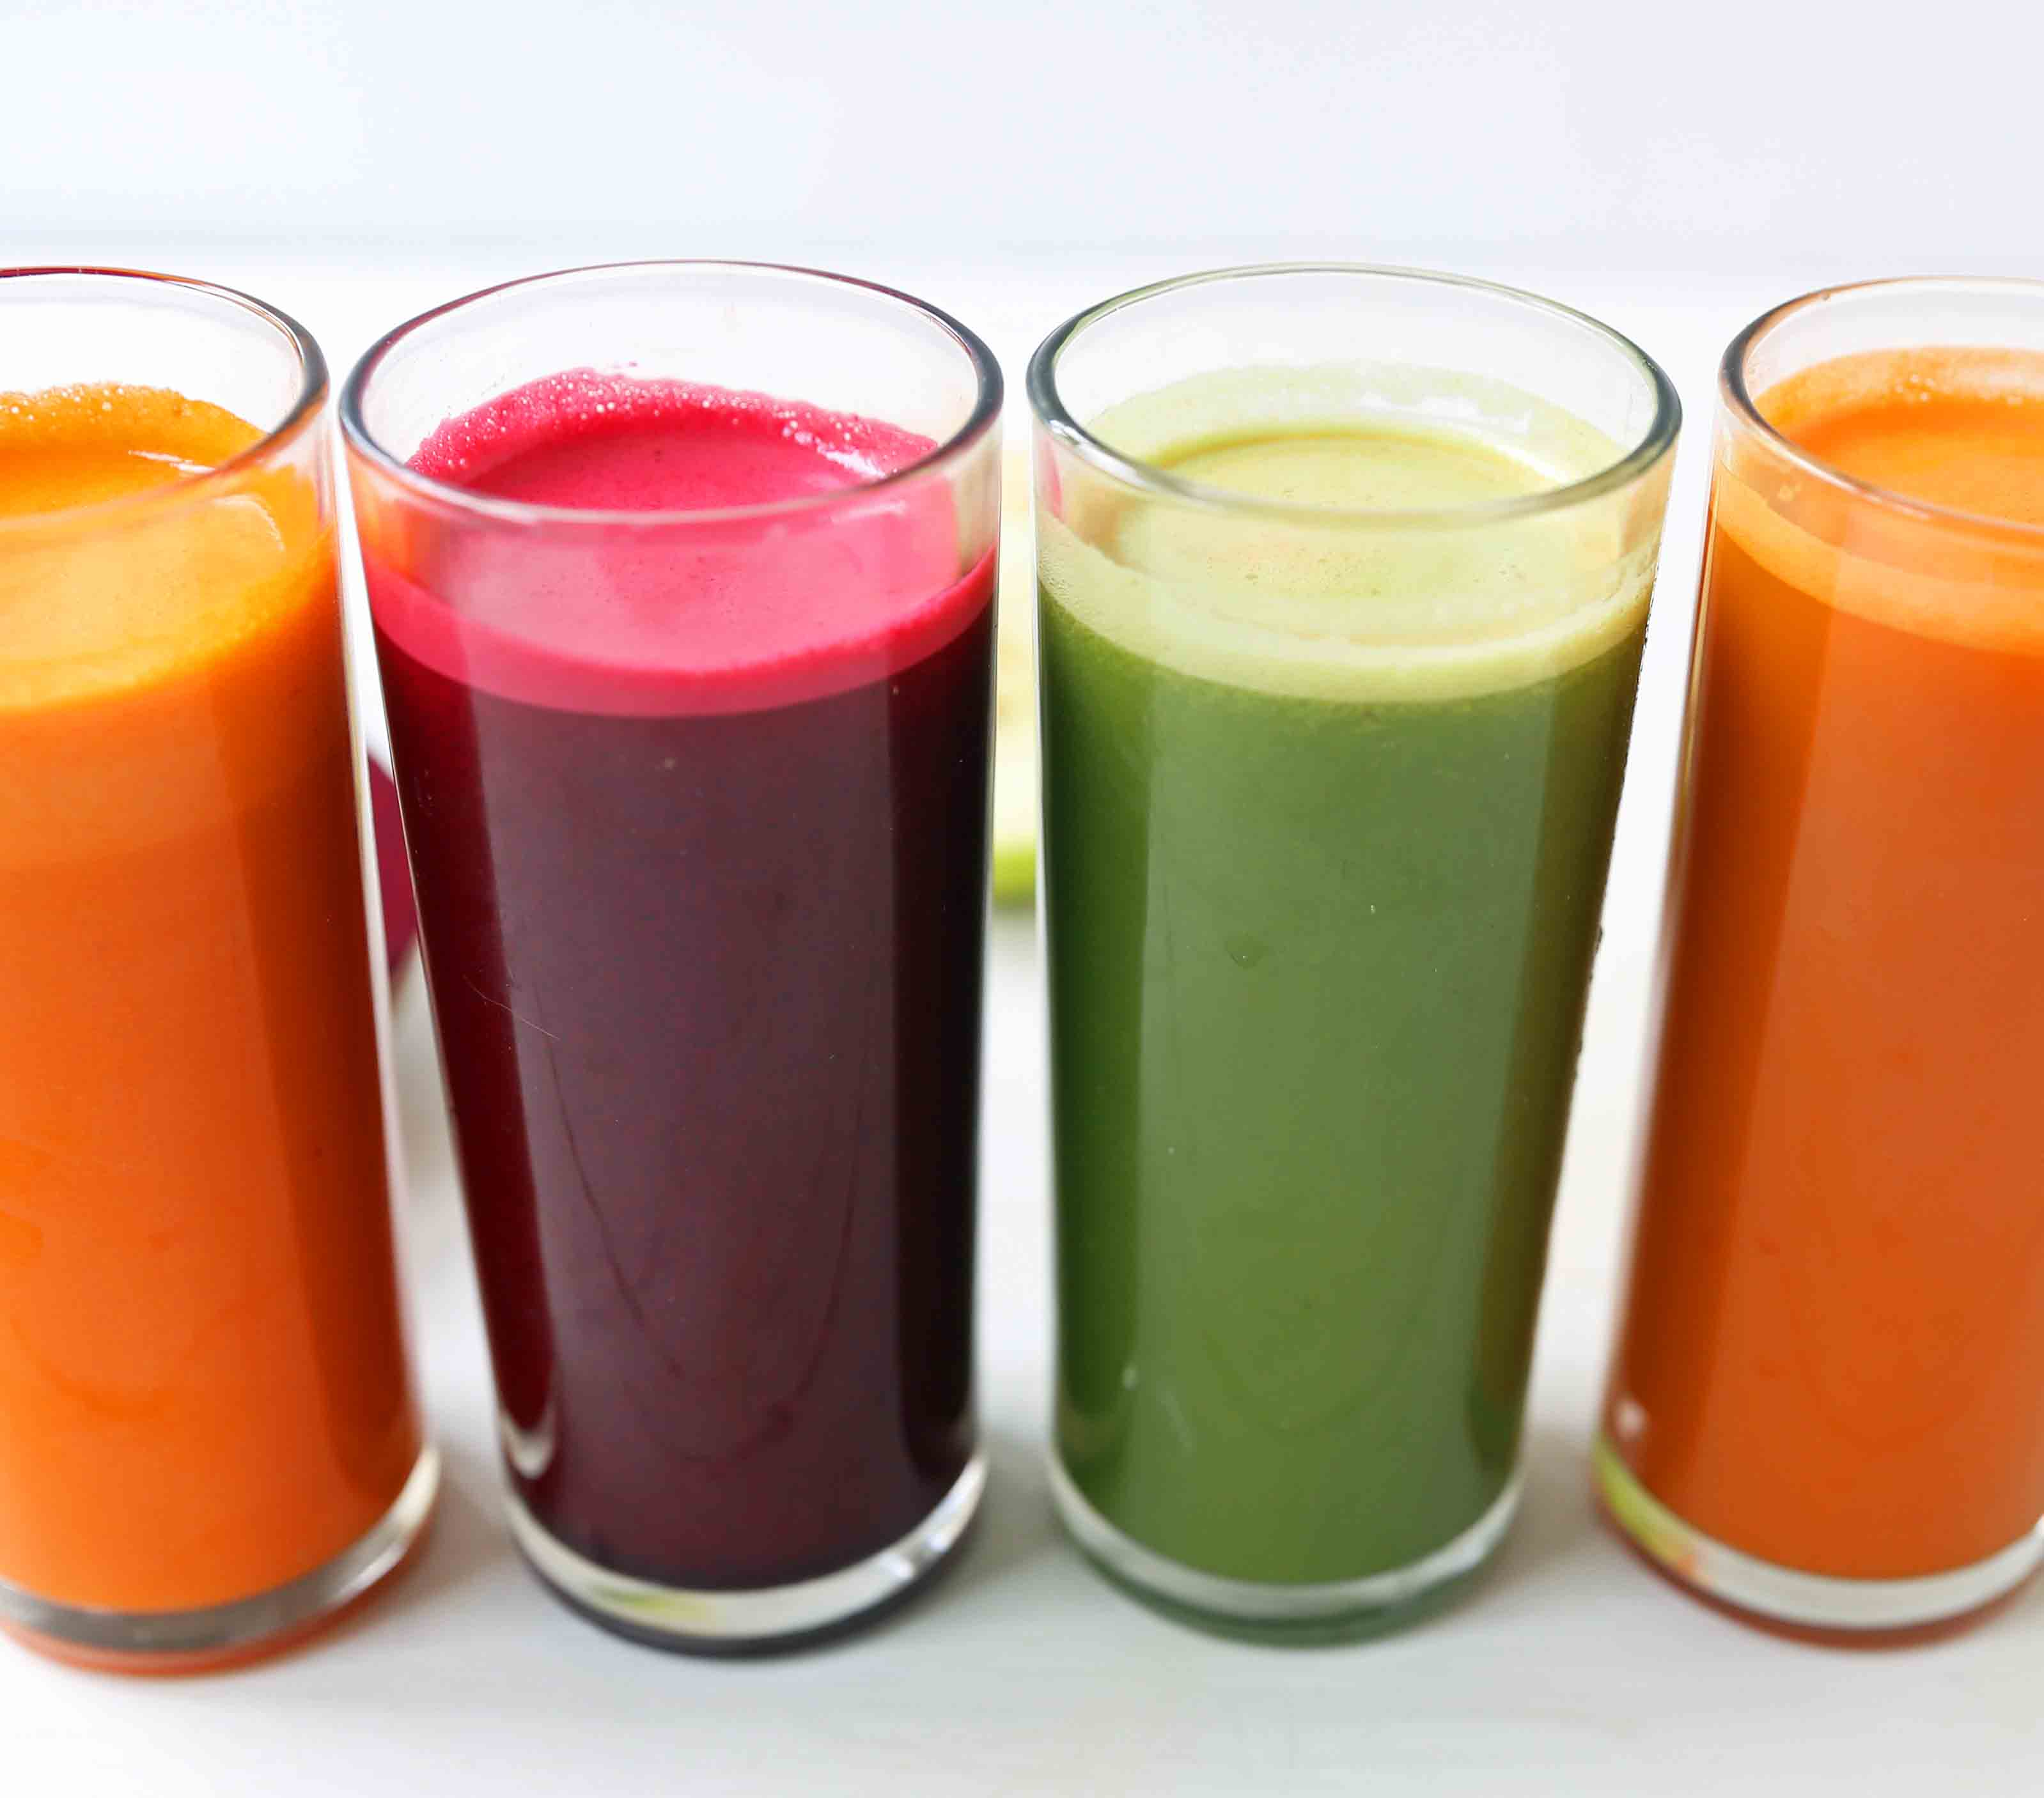
Dietary tips – antioxidants

Slide 22
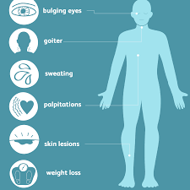
HYPERTHYROIDISM
Overproduction of the thyroid hormones
Notes:
Autoimmune
Graves Disease (76%)
F>M, age 20-40
IgG auto antibodies bind TSH receptors T3 & T4
Leads to gland hyper function
Toxic adenoma and toxic multinodular goitre
Viral Thyroiditis (de Quervain’s)
Fever and ESR- self limiting
Exogenous Iodine
Neonatal thyrotoxicosis
Drugs- Amiodarone
TSH secreting pituitary adenoma (rare)
HCG producing tumour

Slide 23
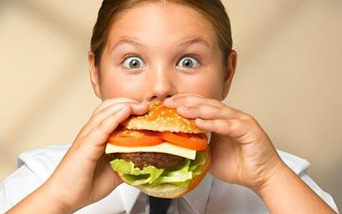
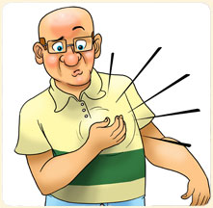
SYMPTOMS of hyperthyroidism

Slide 24
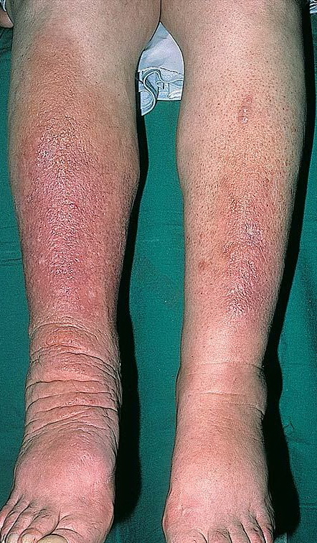
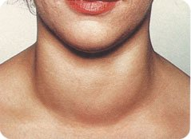
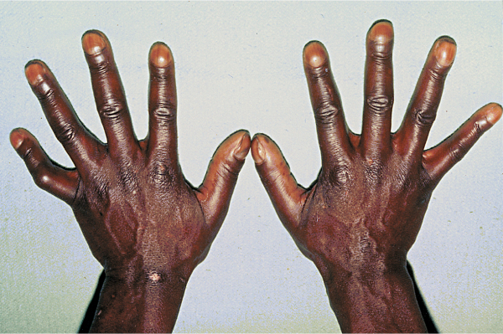
SYMPTOMS

Slide 25
SYMPTOMS OF OVERACTIVE THYROID
Unintentional weight loss
Rapid and Irregular heartbeat
Pounding of your heart ( palpitations)
Increased appetite
Anxiety, Nervousness and confusion
Fine Tremor (hands and fingers)
Sweating
Changes in menstrual patterns

Slide 26
SYMPTOMS OF HYPERTHYROIDISM
Intolerance to heat
More frequent bowel movement ( Diarrhea)
Fine brittle hair
Difficulty sleeping
Fatigue
Skin thinning
Dry swollen eyes
Double vision
Excessive tearing/ protruding eyes

Slide 27
DIETARY TIPS
Iodine, which the thyroid gland uses to produce thyroid hormone. Too much iodine in the diet can increase the production of thyroid hormone.
Calcium and vitamin D are vital because hyperthyroidism can cause problems with bone mineral density.
Foods and drinks containing caffeine can worsen the symptoms of hyperthyroidism.

Slide 28
DIETARY TIPS
Low iodine
Cruciferous vegetables
Low iron and hyperthyroidism
Calcium and vitamin D supplementation
HERBS and SPICES

Slide 30
Thyroid cancer

Slide 31
POST THYROIDECTOMY (TOTAL/PARTIAL)
HEALTHY EATING
FOOD-MEDICATION INTERACTIONS
NUTRIENT SUPPLEMENTATION
MANAGING STRESS

Slide 32
NUTRITION SUPPLEMENTATION
SELENIUM, ZINC
VITAMIN D AND CALCIUM
IRON
DETOX SUPPLEMENTATION
ANTIOXIDANTS SUPPLEMENTATION

Slide 33
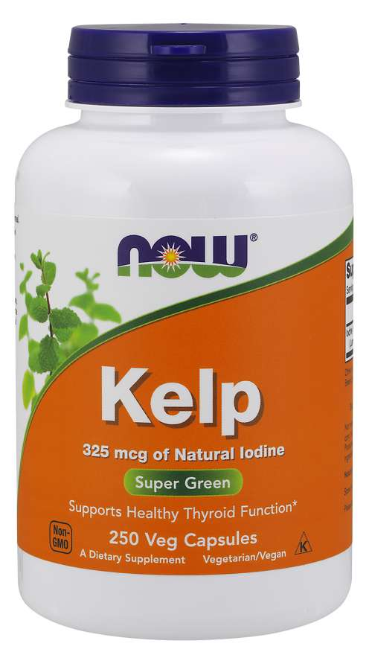
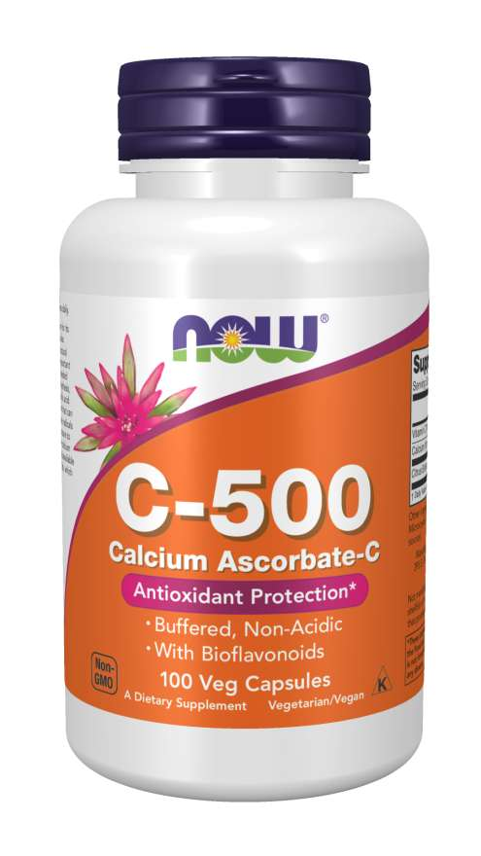
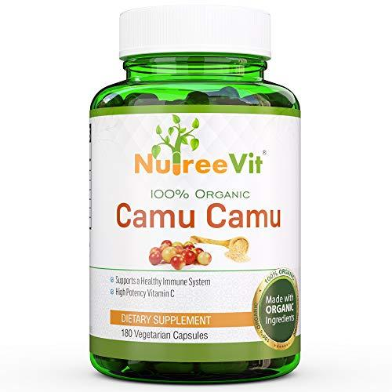

Slide 34
MIND BOY CONNECTION

Slide 35
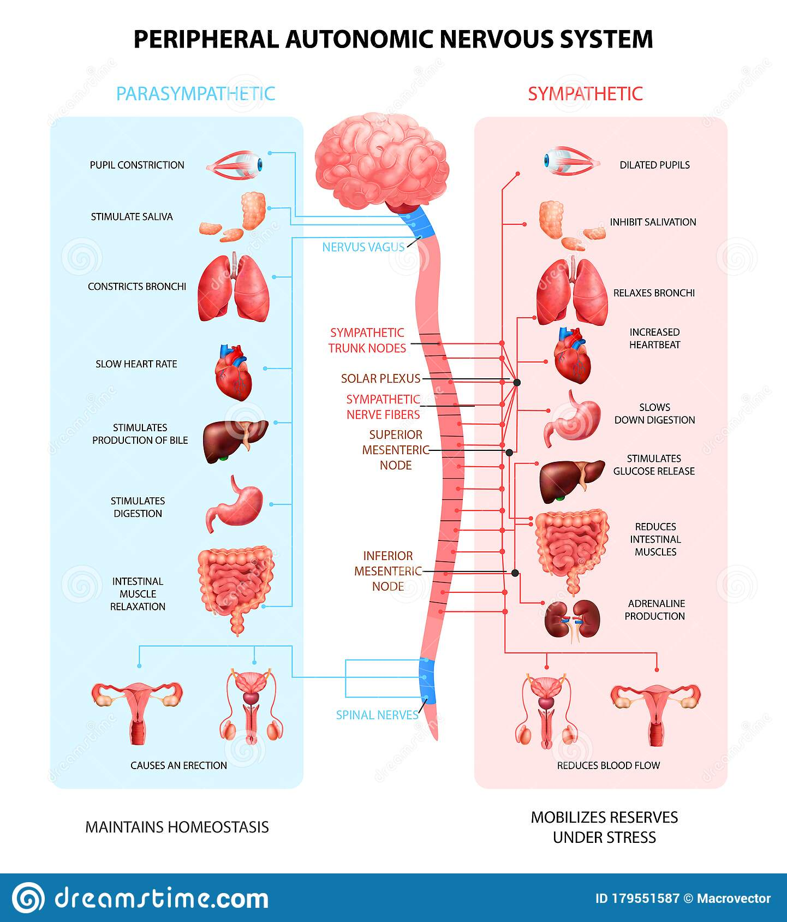

Slide 36
MIND
Thought/Food/Belief/Information
PNS
Rest/Relax/Digest
ANS
SNS
Fight/Flight/Freeze
Necessary chemicals are produce in right amount to each other
Imbalance in chemical production
All cells,tissues,organs,sys. function properly
Cells,tissues,organs,sys do not function properly
Disease
Balance
Wellness
Imbalance

Slide 37
Stress Relieving Techniques
Loving yourself - placing yourself first in all things you do /taking good care of yourself. This begins with accepting God’s love for you.
Deliberately choose information, thoughts and beliefs that makes you happy.

Slide 38
Stress Relieving Techniques
Finding practical ways to solve issues instead of constantly worrying over them
Giving people the benefits of the doubt
Making time to engage in tolerable exercise you enjoy
Spend time with family and friends

Slide 39
Stress Relieving Techniques
Regularly having a good belly laughter
Deep breathing – as many times as you remember, especially when you face negatively stressful situations
Forgiving yourself and others

Slide 40
Stress Relieving Techniques
Make time for hobbies, interest and relaxation
Accept that there are events you cannot control
Listen to music you enjoy
Eat healthy, well balanced meal

Slide 41
Dietary Modification
3-7 DAYS OF INTENSE DETOXIFICATION
1ST 3 DAYS (can be continued for 7 days depending on capacity)
From bed - Therapeutic Tea (TT)
1 hour after TT and Throughout the day - Vegetable smoothies or Juices alone
Bedtime - Therapeutic Tea

Slide 42
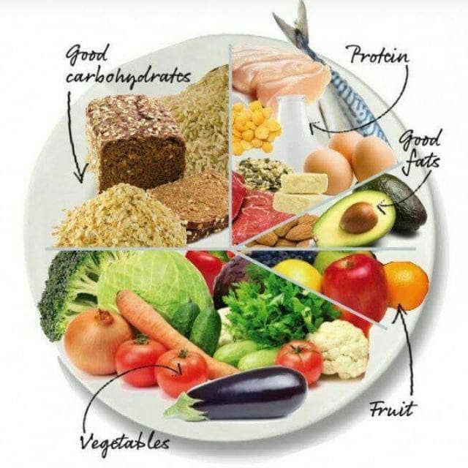
Dietary Modification

Slide 43
Fruits Intake
Banana
Orange

Slide 44
Fruits Intake
Watermelon
Pineapple

Slide 45
Fruits Intake
Apple
Pawpaw

Slide 46
Duration and Frequency of exercise
Exercise 30minutes a day for at least 5 times in a week.

Slide 47
Exercise
Jogging
Brisk Walking

Slide 48
Exercise
Walking
Stretching

Slide 49
Exercise
Skipping Rope
Dancing

Slide 50
Quick facts
RECURRENT CHILDHOOD EAR INFECTIONS AND LACK OF PROPER BREAST FEEDING PROTEINS CAN INCREASE RISK OF THYROID DISORDER
EXPOSURE TO CHEMICALS SUCH AS LEAD AND MERCURY INCREASES THE RISK TO THYROID DISORDERS
XENOESTROGENS PRESENT IN MOST COSMETICS AND PERSONAL CARE PRODUCTS (MAKE-UPS,HAIR DYES, SOAPS AND PERFUMES) HAVE AN ASSOCIATION WITH THYROID DISORDERS.

Slide 51
